Slide 1
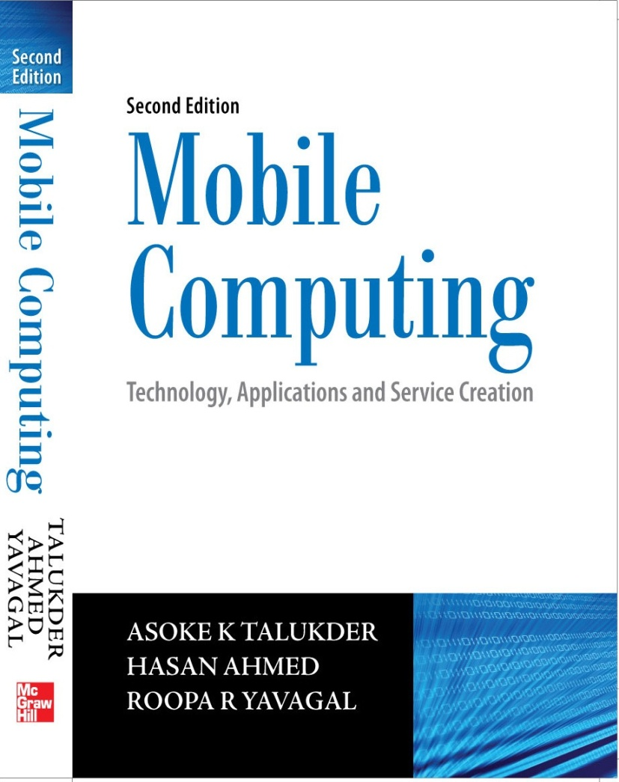
Notes#8
General Packet Radio Service

Slide 2
General Packet Radio Service (GPRS)
General Packet Radio Service
Step to efficiently transport high-speed data over the current GSM and TDMA-based wireless network infrastructures
Deployment of GPRS networks allows a variety of new applications ranging from mobile e-commerce to mobile corporate VPN access
GPRS allows for data speeds of 14.4 KBps to 171.2 KBps, which allow for comfortable Internet access
Allows for short ‘bursty’ traffic, such as e-mail and web browsing, as well as large volumes of data

Slide 3
GPRS
No dial-up modem connection is necessary
Offers fast connection set-up mechanism to offer a perception of being ‘always on’ or ‘always connected’
Immediacy is one of the prime advantages of GPRS

Slide 4
QoS in GPRS
Allows definition of QoS profiles using the parameters of service precedence, reliability, delay and throughput
Service precedence is the priority of a service in relation to another service which can be either high, normal or low
Reliability indicates the transmission characteristics required by an application and guarantees certain maximum values for the probability of loss, duplication, mis-sequencing and corruption of packets
Delay parameters define maximum values for the mean delay and the 95-percentile delay
Throughput specifies the maximum/peak bit rate and the mean bit rate

Slide 5
GPRS Network Architecture
GPRS uses the GSM architecture for voice
To offer packet data services through GPRS, a new class of network nodes called GPRS support nodes (GSN) are introduced
GSNs are responsible for the delivery and routing of data packets between the mobile stations and the external packet data networks (PDN)
Two main GSNs are Serving GSN (SGSN) and Gateway GSN (GGSN)

Slide 6
SGSN
SGSN is at the same hierarchical level as the MSC and so, whatever MSC does for voice, SGSN does for packet data
SGSN’s tasks include packet switching, routing and transfer, mobility management, logical link management, authentication and charging functions
SGSN processes registration of new mobile subscribers and keeps a record of their location inside a given service area
Location register of the SGSN stores location information (like current cell, current VLR, etc.) and user profiles of all GPRS users registered with this SGSN
SGSN sends queries to HLR to obtain profile data of GPRS subscribers

Slide 7
GGSN
GGSN acts as an interface between the GPRS backbone network and the external packet data networks and functions like a router in a LAN
GGSN maintains routing information that is necessary to tunnel Protocol Data Units (PDUs) to the SGSNs that service particular mobile stations
GGSNs convert the GPRS packets coming from the SGSN into the appropriate packet data protocol (PDP) format for the data networks like Internet or X.25
GGSN stores the current SGSN address of the user and user’s profile in its location register while performing authentication and charging functions related to data transfer

Slide 8
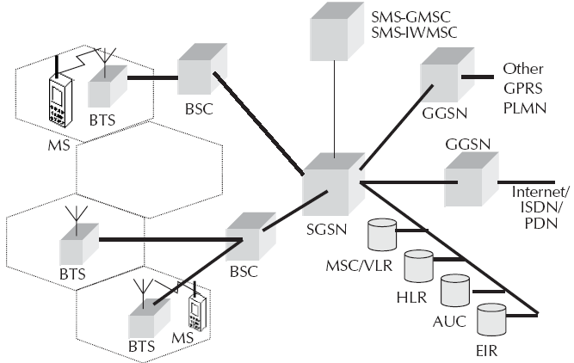
GPRS System Architecture

Slide 9
GPRS Network Enhancements
Base Station System (BSS) needs enhancement to recognize and send packet data and this includes BTS upgrade to allow transportation of user data to the SGSN. BTS, too, needs to be upgraded to support packet data transportation between BTS and MS (mobile station).
HLR needs enhancement to register GPRS user profiles and respond to queries originating from GSNs regarding these profiles.
MS (mobile station) for GPRS is different from that of GSM.
SMS-GMSCs and SMS-IWMSCs are upgraded to support SMS transmission via the SGSN.

Slide 10
Channel Coding
Channel coding is used to protect the transmitted data packets against errors
Channel coding technique in GPRS is quite similar to the one employed in conventional GSM
Under very bad channel conditions, reliable coding scheme is used where redundant bits are added to recover from burst errors
Under good channel conditions, no encoding scheme is used resulting in a higher data rate

Slide 11
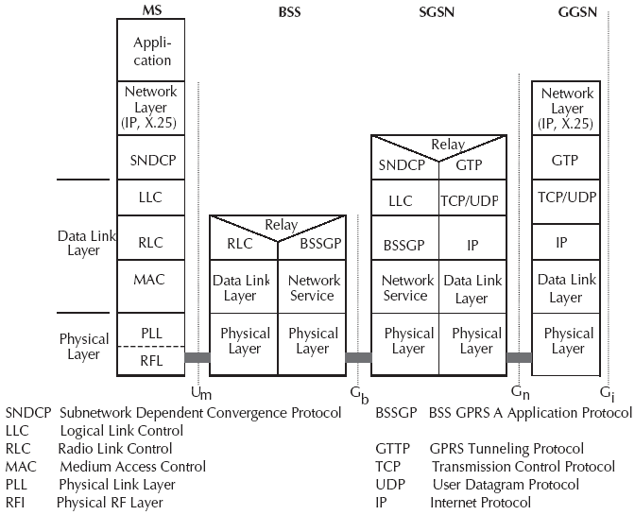
Transmission Plane Protocol Architecture

Slide 12
Signaling Plane
Protocol architecture of the signaling plane comprises protocols for control and support of the functions of the transmission plane and includes GPRS attach and detach, PDP context activation, control of routing paths and allocation of network resources.
Between SGSN and HLR as well as between SGSN and EIR, an enhanced Mobile Application Part (MAP) is employed which is a mobile network specific extension of the Signaling System SS#7 used in GSM and transports the signaling information related to location updates, routing information, user profiles and handovers.
MAP messages are exchanged over Transaction Capabilities Application Part (TCAP) and Signaling Connection Control Part (SCCP) while BSSGP is an enhancement of GSM’s BSSAP.

Slide 13
GPRS Backbone
It includes the transmission plane between SGSN and GGSN.
User data packets and signaling information within GPRS networks are encapsulated using GPRS Tunneling Protocol (GTP) which is also used in both intra-PLMN (between SGSN and GGSN within one PLMN) and inter-PLMN (between SGSN and GGSN of different PLMNs).
GTP protocol tunnels the user data packets through GPRS backbone by adding GPRS specific routing information in the form of GTP packets which can carry data packets from both IP and X.25 data networks.
Finally, GPRS backbone has an IP/X.25-over-GTP-over-UDP/TCP-over-IP transport architecture.

Slide 14
BSS-SGSN Interface
The BSS-SGSN interface is divided into four layers:
Sub-Network Dependent Convergence Protocol (SNDCP) which transfers data packets between SGSN and MS, multiplexes several connections of the network layer onto one virtual logical connection of the underlying LLC layer and does segmentation, compression-decompression of user data.
Logical Link Control (LLC) is data link layer protocol for GPRS which functions similar to Link Access Procedure-D (LAPD) and assures the reliable transfer of user data across a wireless network.

Slide 15
BSS-SGSN Interface
Base Station System GPRS Protocol (BSSGP) delivers routing and QoS related information between BSS and SGSN.
Network Service layer manages the convergence sub-layer that operates between BSSGP and Frame Relay Q.922 Core by mapping BSSGP’s service requests to the appropriate Frame Relay services.

Slide 16
Air Interface
Air interface of GPRS comprises data link layer and physical layer.
Data link layer between MS and BSS is divided into three sublayers: the logical link control (LLC) layer, the radio link control (RLC) layer and the medium access control (MAC) layer.
Physical layer between MS and BSS is divided into two sublayers: the physical link layer (PLL) and the physical RF layer (RFL).

Slide 17
LLC Layer
Logical Link Control (LLC) layer provides a reliable logical link between an MS and its assigned SGSN as its functionality is based on HDLC (High Level Data Link Control) protocol and includes sequence control, in-order delivery, flow control, detection of transmission errors and retransmissions.
Encryption is used.
Variable frame lengths are possible and both acknowledged and unacknowledged data transmission modes are supported.

Slide 18
RLC Layer
Radio Link Control (RLC) layer establishes a reliable link between MS and BSS.
It also does segmentation and reassembly of LLC frames into RLC data blocks and ARQ of uncorrectable data.

Slide 19
MAC Layer
Medium Access Control (MAC) layer controls the access attempts of an MS on the radio channel shared by several MSs by employing algorithms for contention resolution, multi-user multiplexing on a packet data traffic channel (PDTCH) and scheduling and prioritizing based on the negotiated QoS.

Slide 20
PL Layer
Physical Link Layer (PLL) provides services for information transfer over a physical channel between the MS and the network.
Its functions include data unit framing, data coding and detection and correction of physical medium transmission errors.
Physical Link Layer uses the services of the Physical RF Layer.

Slide 21
PRF Layer
Physical RF Layer (RFL) performs the modulation of the physical waveforms based on the sequence of bits received from the Physical Link Layer above.
It also demodulates received wave forms into a sequence of bits that are transferred to the Physical Link layer for interpretation.

Slide 22
Radio Resource Management
On the radio interface, GPRS uses a combination of FDMA and TDMA.
A series of logical channels are defined to perform functions like signaling, broadcast of general system information, synchronization, channel assignment, paging or payload transport.
Such channels can be divided into two categories: traffic channels and signaling channels.
GPRS traffic channels are allocated when data packets are sent or received and they are released after the transmission of data.
GPRS allows a single mobile station to use multiple time slots of the same TDMA frame for data transmission which is known as multi-slot operation and uses a very flexible channel allocation.

Slide 23
Radio Resource Management
Uplink and downlink channels are allocated separately which efficiently supports asymmetric data traffic like Internet.
Physical channels to transport user data packet are called Physical Data Traffic Channel (PDTCH) which are taken from a common pool of all channels available in a cell.
Mapping of physical channels to either packet switched data (in GPRS mode) or circuit switched data (in GSM mode) services are performed dynamically depending on demand.
Demand-wise, the number of channels allocated for GPRS can be changed. For example, physical channels not currently in use by GSM can be allocated as PDTCHs to increase the bandwidth of a GPRS connection.

Slide 24
Security
GPRS security is similar to the existing GSM security.
SGSN performs authentication and cipher setting procedures based on the same algorithms, keys and other criteria of GSM.
GPRS uses a ciphering algorithm optimized for packet data transmission.

Slide 25
Attachment and Detachment in GPRS
MS registers itself with SGSN of GPRS network through a GPRS attach which establishes a logical link between the MS and the SGSN.
Network checks if MS is authorized to use the services; if so, it copies the user profile from HLR to SGSN and assigns a Packet Temporary Mobile Subscriber Identity (P-TMSI) to the MS.
To exchange data packets with external PDNs after a successful GPRS attach, an MS must apply for an address which is called PDP (Packet Data Protocol) address.
For each session, a PDP context is created which contains PDP type (e.g. IPv4), PDP address assigned to the mobile station (e.g. 129.187.222.10), requested QoS and address of the GGSN that will function as an access point to the PDN.

Slide 26
Attachment and Detachment in GPRS
Such a context is stored in MS, SGSN and GGSN while with an active PDP context, the MS is ‘visible’ to the external PDN.
A user may have several simultaneous PDP contexts active at a given time and user data is transferred transparently between MS and external data networks trough GTP encapsulation and tunneling.
Allocation of the PDP address can be static or dynamic.
In case of static address, the network operator permanently assigns a PDP address to the user while in other case, a PDP address is assigned to the user upon the activation of a PDP context.

Slide 27
PDP Context Activation
Using the message ‘activate PDP context request’, MS informs the SGSN about the requested PDP context and if request is for dynamic PDP address assignment, the parameter PDP address will be left empty.
After necessary security steps, if authentication is successful, SGSN will send a ‘create PDP context request’ message to the GGSN, the result of which is a confirmation message ‘create PDP context response’ from the GGSN to the SGSN, which contains the PDP address.
SGSN updates its PDP context table and confirms the activation of the new PDP context to the MS.
Disconnection from the GPRS network is called GPRS detach in which all the resources are released.

Slide 28
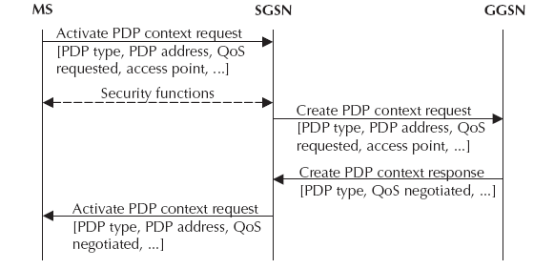
PDP Context Activation

Slide 29
Mobility Management
Mobility Management functions are used to track its location within each PLMN in which SGSNs communicate with each other to update the MS’s location in the relevant registers.
Profiles of MSs are preserved in VLRs that are accessible to SGSNs via the local MSC.
A logical link is established and maintained between the MS and the SGSN at each PLMN.
At the end of transmission or when a mobile station moves out of area of a specific SGSN, the logical link is released and the resources associated with it can be reallocated.

Slide 30
Routing
Routing is the process of how packets are routed in GPRS.
Here, the example assumes two intra-PLMN backbone networks of different PLMNs. Intra-PLMN backbone networks connect GSNs of the same PLMN or the same network operator.
These intra-PLMN networks are connected with an inter-PLMN backbone while an inter-PLMN backbone network connects GSNs of different PLMNs and operators. However, a roaming agreement is necessary between two GPRS network providers.
Gateways between PLMNs and external inter-PLMN backbone are called border gateways which perform security functions to protect the private intra-PLMN backbones against malicious attacks.

Slide 31
Routing
Let’s say that GPRS MS located in PLMN1 sends IP packets to a host connected to the IP network (e.g. to a Web server connected to the Internet).
SGSN that the MS is registered with encapsulates the IP packets coming from the mobile station, examines the PDP context and routes them through the intra-PLMN GPRS backbone to the appropriate GGSN.
GGSN de-encapsulates the packets and sends them out on the IP network, where IP routing mechanisms are used to transfer the packets to the access router of the destination network and finally, delivers the IP packets to the host.

Slide 32
Routing
Let us also say that home-PLMN of the mobile station is PLMN2.
An IP address has been assigned to MS by the GGSN of PLMN2 and so, MS’s IP address has the same network prefix as the IP address of the GGSN in PLMN2.
Correspondent host is now sending IP packets to the MS onto the IP network and are routed to the GGSN of PLMN2 (the home-GGSN of the MS). The latter queries the HLR and obtains the information that the MS is currently located in PLMN1.
It encapsulates the incoming IP packets and tunnels them through the inter-PLMN GPRS backbone to the appropriate SGSN in PLMN1 while the SGSN de-encapsulates the packets and delivers them to the MS.

Slide 33
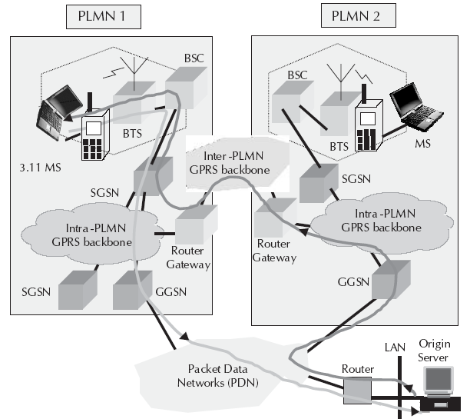
Routing

Slide 34
Routing
HLR stores the user profile, the current SGSN address and the PDP addresses for every GPRS user in the PLMN.
When the MS registers with a new SGSN, HLR will send the user profile to the new SGSN.
Signaling path between GGSN and HLR may be used by the GGSN to query a user’s location and profile in order to update its location register.

Slide 35
Communicating with IP Networks
A GPRS network can be interconnected with Internet or a corporate intranet and supports both IPv4 and IPv6.
From an external IP network’s point of view, the GPRS network looks like any other IP sub-network, and the GGSN looks like a usual IP router.
Each registered user who wants to exchange data packets with the IP network gets an IP address which is taken from the address space of the GPRS operator maintained by a Dynamic Host Configuration Protocol (DHCP) server.
Address resolution between IP address and GSM address is performed by the GGSN using the appropriate PDP context.

Slide 36
Communicating with IP Networks
Domain Name Server (DNS) managed by the GPRS operator or the external IP network operator is used to resolve host name.
To protect the PLMN from unauthorized access, a firewall is installed between the private GPRS network and the external IP network.
Thus, GPRS can be seen as a wireless extension of the Internet all the way to a MS or mobile computer as mobile user has a direct connection to the Internet.

Slide 37
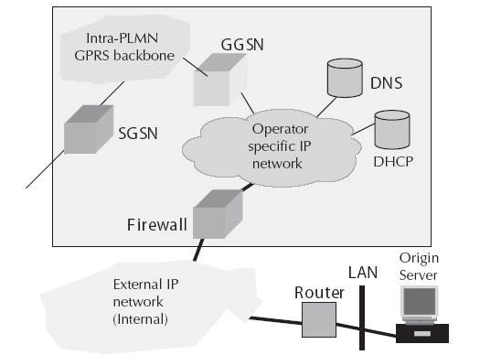
Communicating with IP Networks

Slide 38
Data Services in GPRS
Any user is likely to use either of the two modes of the GPRS network: application mode or tunneling mode.
In application mode, user uses the GPRS mobile phone to access the applications running on the phone itself. The phone here acts as the end user device.
In tunneling mode, user uses GPRS interface as an access to the network as the end user device would be a large footprint device like laptop computer or a small footprint device like PDA. The mobile phone will be connected to the device and used as a modem to access the wireless data network.

Slide 39
GPRS Handsets
GPRS terminal can be one of the three classes: A, B or C.
Class A terminal supports GPRS data and other GSM services such as SMS and voice simultaneously. This includes simultaneous attach, activation, monitoring and traffic. As such, a class A terminal can make or receive calls on two services simultaneously while supporting SMS.
Class B terminal can monitor GSM and GPRS channels simultaneously, but can support only one of these services at any time. Therefore, a Class B terminal can support simultaneous attach, activation, and monitoring but not simultaneous traffic. Users can make or receive calls on either a packet or a switched call type sequentially but not simultaneously. SMS is supported in class B terminals.

Slide 40
GPRS Handsets
Class C terminal supports only non-simultaneous attach. The user must select which service to connect to. Therefore, a class C terminal can make or receive calls from only the manually selected network service (and so, the service that is not selected is not reachable). The GPRS specifications state that support of SMS is optional for class C terminals.
Each handset will have a unique form factor. So, terminals will be available in the standard form factor with a numeric keypad and a relatively small display. Other types of phones with different form factors, color displays, cameras are common apart from the latest smart phones.

Slide 41
Bearers in GPRS
Bearer services of GPRS offer end-to-end packet switched data transfer.
GPRS supports two different kinds of data transport services: point-to-point (PTP) services and point-to-multipoint (PTM) services.
GPRS continues to support SMS as a bearer.
Wireless Application Protocol is a data bearer service over HTTP protocol, supported by GPRS.
Multimedia Messaging Service, too, is supported by GPRS.

Slide 42
Applications of GPRS
Chat
Multimedia Services
Virtual Private Network
Personal Information Management
Job Sheet Dispatch
Unified Messaging
Vehicle Positioning
Location based services and Telematics

Slide 43
Limitations of GPRS
Limited cell capacity for all users
Lower access speed in reality
No support of GPRS Mobile Terminate Connection for a mobile server

Slide 44
Billing and Tariffing
Minimum charging information that must be collected are:
Destination and source addresses
Usage of radio interface
Usage of external Packet Data Networks
Usage of the packet data protocol addresses
Usage of general GPRS resources and location of the Mobile Station

Slide 45
Billing and Tariffing
Various business models exist for charging customers as billing of services can be based on the transmitted data volume, the type of service, the chosen QoS profile, etc.
GPRS call records are generated in the GPRS Service Nodes.
Packet counts are passed to a Charging Gateway that generates Call Detail Records that are sent to the billing system.

Slide 46
Next Chapter
Wireless Application Protocol
Thanks

